Slide 1
CREATIVE WRITING
- BACHELORS OF
ARTS IN ENGLISH
Here is where your presentation begins

Slide 2
CONTENTS OF THIS TEMPLATE
You can delete this slide when you’re done editing the presentation
Fonts | To view this template correctly in PowerPoint, download and install the fonts we used
Used and alternative resources | An assortment of graphic resources that are suitable for use in this presentation
Thanks slide | You must keep it so that proper credits for our design are given
Colors | All the colors used in this presentation
Icons and infographic resources | These can be used in the template, and their size and color can be edited
Editable presentation theme | You can edit the master slides easily. For more info, click here
For more info: Slidesgo | Blog | FAQs
You can visit our sister projects: Freepik | Flaticon | Storyset | Wepik | Videvo

Slide 3
TABLE OF CONTENTS
01
02
03
04
05
06
INTRODUCTION
WORDS POWER
CREATIVITY
You can describe the topic of the section here
You can describe the topic of the section here
You can describe the topic of the section here
INSPIRATION
STORYTELLING
FICTION
You can describe the topic of the section here
You can describe the topic of the section here
You can describe the topic of the section here

Slide 4
WHOA!
This can be the part of the presentation where you introduce yourself, write your email…

Slide 5
01
INTRODUCTION
You can enter a subtitle
here if you need it

Slide 6
THE ART OF STORYTELLING
Mercury is the closest planet to the Sun and the smallest one in the entire Solar System. Contrary to popular belief, this planet’s name has nothing to do with the liquid metal. Mercury was, instead, named after the famous Roman messenger god Mercurius
Mercury takes a little more than 58 days to complete its rotation, so try to imagine how long days must be there! Since the temperatures are so extreme, albeit not as extreme as on Venus, Mercury has been deemed to be non-habitable for humans

Slide 7
WRITING STYLES
Do you know what helps you make your point crystal clear? Lists like this one:
They’re simple
You can organize your ideas clearly
You’ll never forget to buy milk!
And the most important thing: the audience won’t miss the point of your presentation

Slide 8
THE POWER OF WORDS
MERCURY
VENUS
Mercury is the closest planet to the Sun and the smallest one in the Solar System—it’s only a bit larger than the Moon
Venus has a beautiful name and is the second planet from the Sun. It’s hot and has a poisonous atmosphere

Slide 9
THE IMPORTANCE OF CREATIVITY
MERCURY
VENUS
MARS
Mercury is the closest planet to the Sun and the smallest of them all
Venus has a beautiful name and is the second planet from the Sun
Despite being red, Mars is actually a cold place. It’s full of iron oxide dust

Slide 10
CRAFT OF FICTION
MARS
VENUS
Mars is actually a very cold place
Venus has extremely high temperatures
JUPITER
SATURN
Jupiter is the biggest planet of them all
Saturn is a gas giant and has several rings

Slide 11
THE ROLE OF CONFLICT
MARS
VENUS
NEPTUNE
Mars is actually a very cold place
Venus has extremely high temperatures
Neptune is the farthest planet from the Sun
MERCURY
SATURN
JUPITER
Mercury is the closest planet to the Sun
Saturn is a gas giant and has several rings
Jupiter is the biggest planet of them all

Slide 12
AWESOME WORD

Slide 13
—SOMEONE FAMOUS
“This is a quote, words full of wisdom that someone important said and can make the reader get inspired”

Slide 14
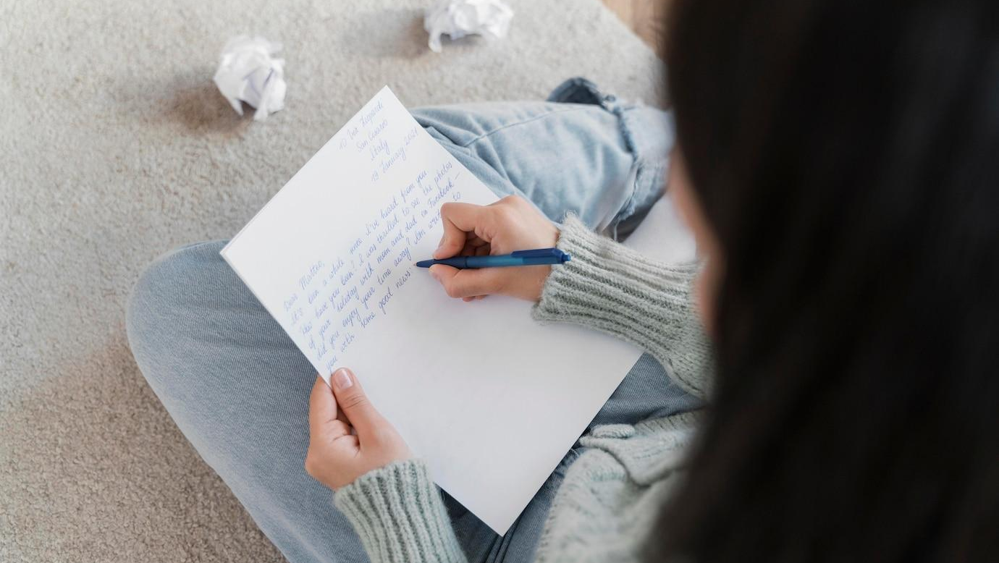
A PICTURE IS WORTH A THOUSAND WORDS

Slide 15
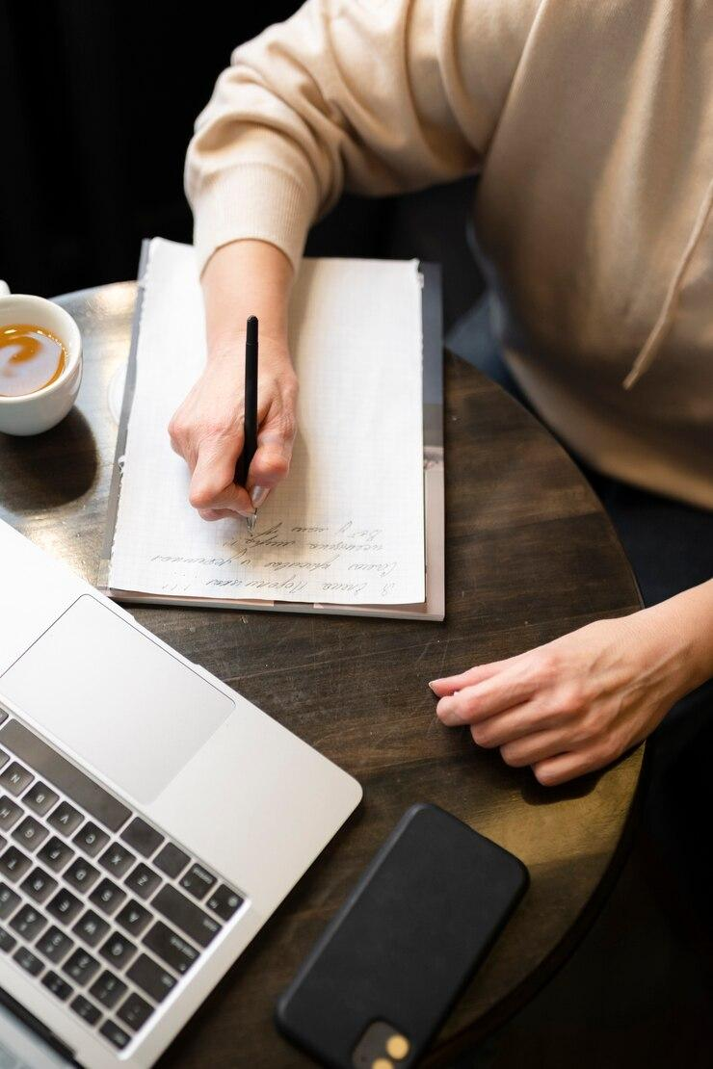
A PICTURE ALWAYS REINFORCES
THE CONCEPT
Images reveal large amounts of data, so remember: use an image instead of a long text. Your audience will appreciate it

Slide 16
98,300,000
Big numbers catch your audience’s attention

Slide 17
9h 55m 23s
333,000
386,000 km
Jupiter’s rotation period
The Sun’s mass compared to Earth’s
Distance between Earth and the Moon

Slide 18
THE POWER OF DIALOGUE
25%
50%
25%
MERCURY
VENUS
MARS
Mercury is the closest planet to the Sun and the smallest of them all
Venus has a beautiful name and is the second planet from the Sun
Despite being red, Mars is actually a cold place. It’s full of iron oxide dust

Slide 19
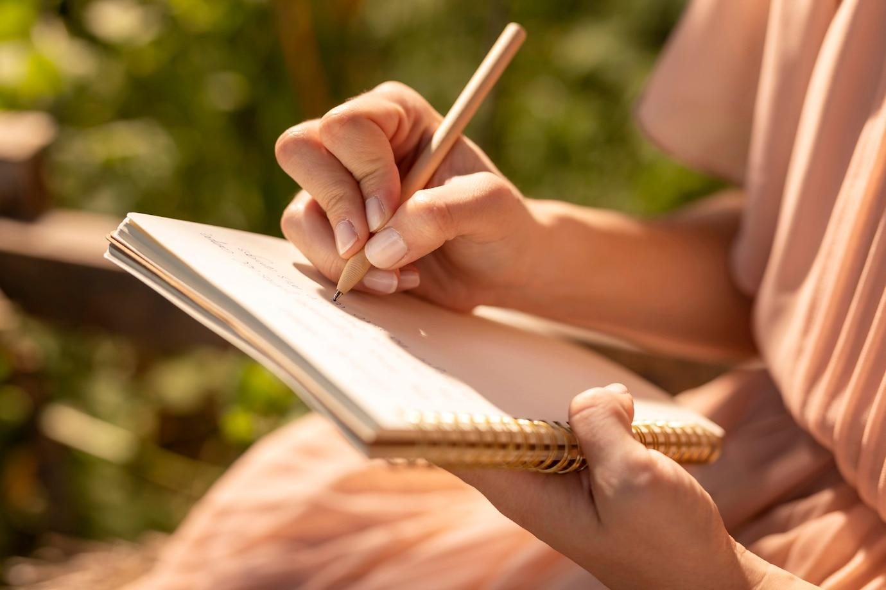
COMPUTER MOCKUP
You can replace the image on the screen with your own work. Just right-click on it and select “Replace image”

Slide 20
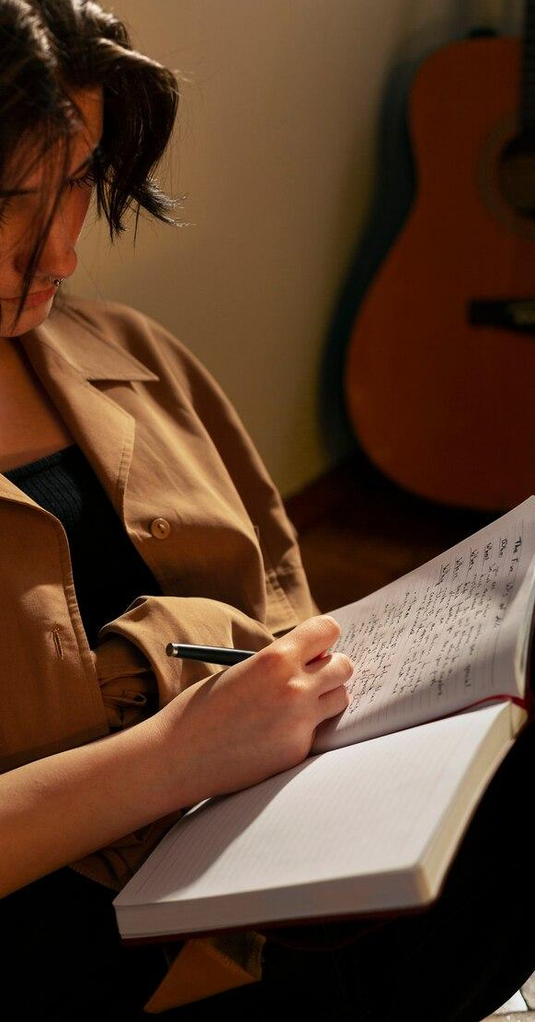
PHONE MOCKUP
You can replace the image on the screen with your own work. Just right-click on it and select “Replace image”

Slide 21
VARIOUS WRITING STYLES
VENUS
Venus is the second planet from the Sun
MERCURY
Mercury is the closest planet to the Sun
MARS
Despite being red, Mars is a very cold place

Slide 22
WRITER’S JOURNEY
Venus is the second planet from the Sun
Despite being red, Mars is a very cold place
VENUS
MARS
MERCURY
JUPITER
Mercury is the closest planet to the Sun
Jupiter is the biggest planet of them all

Slide 23
THE ART OF DESCRIPTION
MARS
SATURN
Despite being red, Mars is a cold place
Saturn is a gas giant and has rings
MERCURY
VENUS
It’s the closest planet to the Sun
It’s the second planet from the Sun

Slide 24
ELEMENTS OF STYLE
 | TEAM A | TEAM B | TEAM C | TEAM D
MERCURY | 0.06 | 0.53 | 0.38 | 0.38
MARS | 0.11 | 9.4 | 0.53 | 0.78
SATURN | 95.2 | 1.16 | 9.4 | 1.16

Slide 25
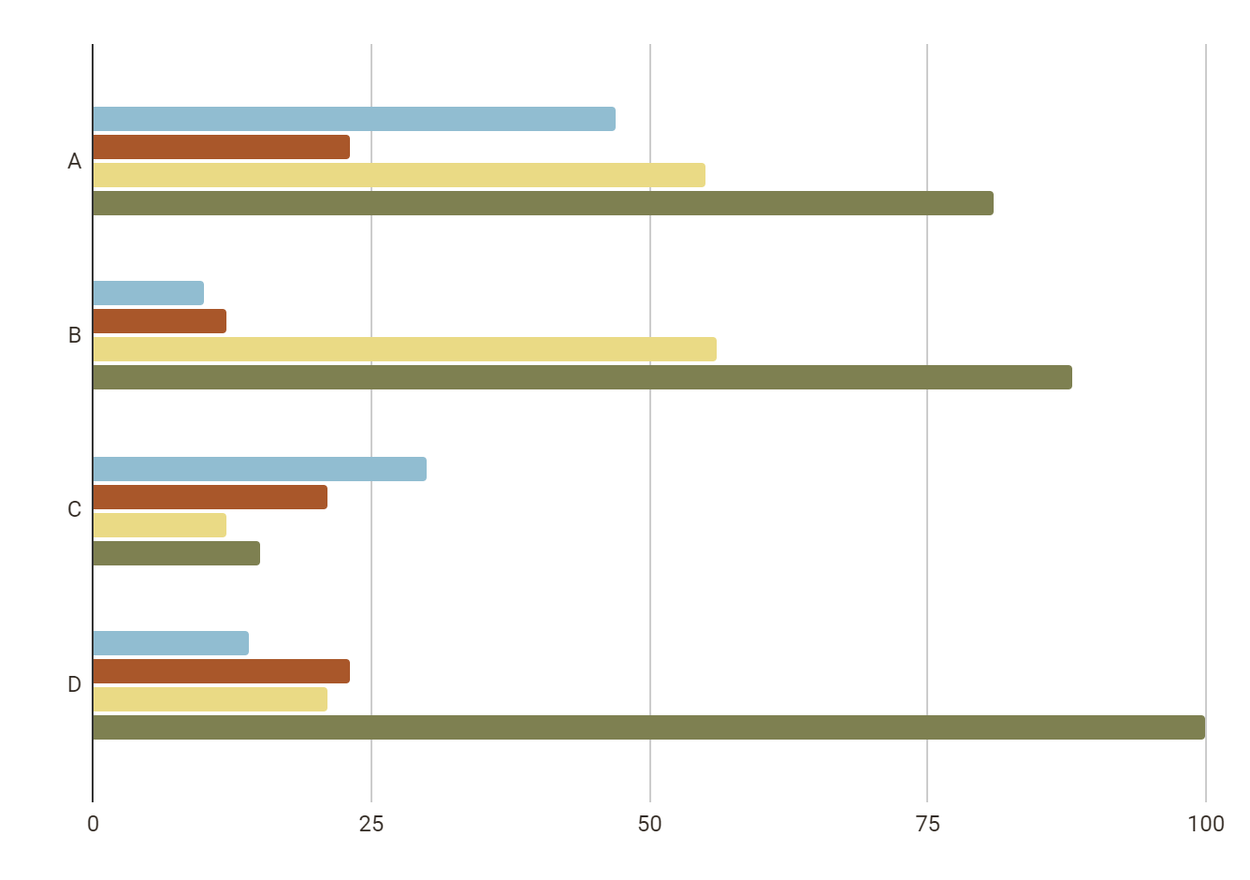
PRACTICE YOUR SKILL
MERCURY
VENUS
JUPITER
SATURN
Mercury is quite a small planet
Venus has very high temperatures
Jupiter is an enormous planet
Saturn is a gas giant and has rings
Follow the link in the graph to modify its data and then paste the new one here. For more info, click here

Slide 26


OUR MENTORS
MARK ANDERSON
ALLIE HARRISON
You can speak a bit about this person here
You can speak a bit about this person here

Slide 27
DIAGRAM
Illustration
Index
Plot
Text
Glossary
Fantasy
Title
Photographs
Theme
Biography

Slide 28
SCHEDULE/PLANNER
M | TU | W | TH | F | SA | SU
30 | 1 | 2 | 3 | 4 | 5 | 6
7 | 8 | 9 | 10 | 11 | 12 | 13
14 | 15 | 16 | 17 | 18 | 19 | 20
21 | 22 | 23 | 24 | 25 | 26 | 27
28 | 29 | 30 | 31 | 1 | 2 | 3
LESSON 1
LESSON 2
QUIZ
LESSON 3
LESSON 4
EXAMINATION

Slide 29
ASSIGNMENT BRIEF
INTRODUCTION | Mercury is the closest planet to the Sun and the smallest of them all
ASSIGNMENT DESCRIPTION | Venus is extremely hot, even more than Mercury
ASSIGNMENT TASKS | Earth is the only planet known to harbor life
GRADING CRITERIA | Despite being red, Mars is actually a cold place
RESOURCES | Jupiter is the biggest planet in the Solar System
CONCLUSION | Saturn is the second-largest planet in the Solar System

Slide 30
RUBRIC
 | GOOD | ACCEPTABLE | POOR | UNACCEPTABLE
ORGANIZATION AND ARGUMENTATION | Venus is very hot | Mars is very cold | Jupiter is big | Saturn has rings
SOURCE USE | Earth has life | Jupiter is big | Neptune is far away | Mars is very cold
TYPOGRAPHY AND WRITING STYLE | Mars is very cold | Neptune is far away | Venus is very hot | Earth has life

Slide 31
EXERCISE 1
Write a short story about a character who discovers a hidden talent. Explore the character’s journey of self-discovery and how they overcome any obstacles along the way
Write your answer here...

Slide 32
EXERCISE 2
Choose 2 topics from this list and then combine them to create a creative writing!
Time travel
Your future self
The beauty
of nature
Deserted in
an island
Favorite writer
Hidden talent
Friendship
Difficult decision
Your past self
Different world
Power of imagination
Personal challenge

Slide 33
STORY BREAKDOWN
IDEA 1
BREAKDOWN 1
IDEA 2
MAIN IDEA
IDEA 3
BREAKDOWN 2
IDEA 4

Slide 34
STORY IDEA AND ITS COMPONENTS
STORY 1 | STORY 2 | STORY 3 | STORY 4
Small Red Cold Rocky | Small Hot Dry Vulcanic | Small Hot Rocky Cratered | Large Cold Grassy Striped
Mars is actually a very cold place | Venus is the second planet from sun | Mercury is quite a small planet | Jupiter is the biggest planet of them all

Slide 35
THANKS!
DO YOU HAVE ANY QUESTIONS?
youremail@freepik.com
+34 654 321 432
yourwebsite.com
Please keep this slide for attribution

Slide 36
ALTERNATIVE RESOURCES
Here’s an assortment of alternative resources whose style fits that of this template:
VECTORS:
Hand drawn flat design poetry illustration
Hand drawn flat design literature illustration

Slide 37
RESOURCES
Did you like the resources on this template? Get them on these websites:
VECTORS:
Hand drawn glossary illustration I
Hand drawn glossary illustration II
Hand drawn essay illustration
PHOTOS:
Portrait woman writing letter
Elderly woman drinking coffee at a cafe while working on her laptop and writing on her notebook
Hand writing on notebook close up
Side view woman with journal at home
Person reading cell phone messages
Front view casual woman holding bags

Slide 38
Instructions for use
If you have a free account, in order to use this template, you must credit Slidesgo by keeping the Thanks slide
As a Free user, you are allowed to:
Modify this template
Use it for both personal and commercial projects
You are not allowed to:
Sublicense, sell or rent any of Slidesgo Content
Distribute Slidesgo Content unless it has been expressly authorized by Slidesgo
Include Slidesgo Content in an online or offline database or file
Offer Slidesgo templates (or modified versions of Slidesgo templates) for download
Acquire the copyright of
Slidesgo Content
For more information about editing slides, please read our FAQs or visit our blog

Slide 39
Instructions for use (premium users)
As a Premium user, you can use this template without attributing Slidesgo or keeping the Thanks slide
You are allowed to:
Modify this template
Use it for both personal and commercial projects
Share this template in an
editable format
Hide or delete the “Thanks” slide and the mention to Slidesgo in the credits
You are not allowed to:
Sublicense, sell or rent any of Slidesgo Content
Distribute Slidesgo Content unless it has been expressly authorized by Slidesgo
Use any of the elements that are part in a separated way
Register any of the elements as a trademark or logo in an intellectual property registry
For more information about editing slides, please read our FAQs or visit our blog

Slide 40
Fonts
Colors
This presentation has been made using the following fonts:
All the colors used in this presentation
Click on the button of the link to the fonts
#322a23
#f3ede6
#91bdd1
Archivo
#a9572a
#eada85
#7e8051
IBM Plex Sans
To view this template correctly in PowerPoint, download and install the fonts we used
#c36666
#ffc6a0
#b47a44
#ffffff

Slide 41
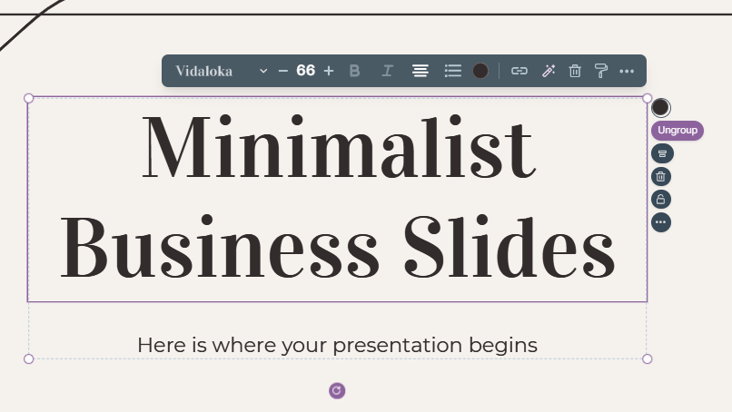
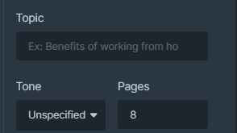
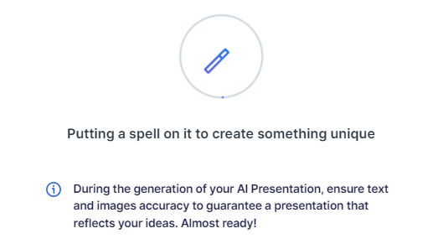
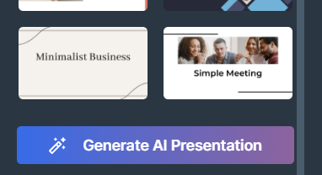
Presentation Maker
Slidesgo introduces its latest feature: the Presentation Maker. Enjoy two main functionalities - firstly, with a few clicks, create marvelous presentations with Artificial Intelligence that adapt to your needs. And it's completely free!
The second functionality of this tool is that you can edit presentations through the online editor. Create interactive resources easily, quickly and without the need for any software. Change everything or start from scratch
Generate AI Presentation
Edit online

Slide 42
Use our editable graphic resources...
You can easily resize these resources without losing quality. To change the color, just ungroup the resource and click on the object you want to change. You can also look for more infographics on Slidesgo

Slide 45
 | Jan | Feb | Mar | Apr | Jun
Task 1
Task 2
Task 3
 | No | Yes | Yes | No | Yes
 | Yes | No | Yes | No | Yes
 | Yes | Yes | No | Yes | No
 | Jan | Feb | Mar | Apr | Jun
Task 1
Task 2
Task 3

Slide 47
6/10 | 8/10 | 7/10 | 4/10

Slide 48
...and our sets of editable icons
You can resize these icons without losing quality
You can change the stroke and fill color; just select the icon and click on the paint bucket/pen
In Google Slides, you can also use Flaticon’s extension, allowing you to customize and add even more icons

Slide 49
Educational icons
Medical icons

Slide 50
Business icons
Teamwork icons

Slide 51
Help & support icons
Avatar icons

Slide 52
Creative process icons
Performing arts icons

Slide 53
Nature icons

Slide 54
SEO & marketing icons

Slide 55


